Slide 1
Appendix

Slide 2
A.1 STM32 Notes

Slide 3
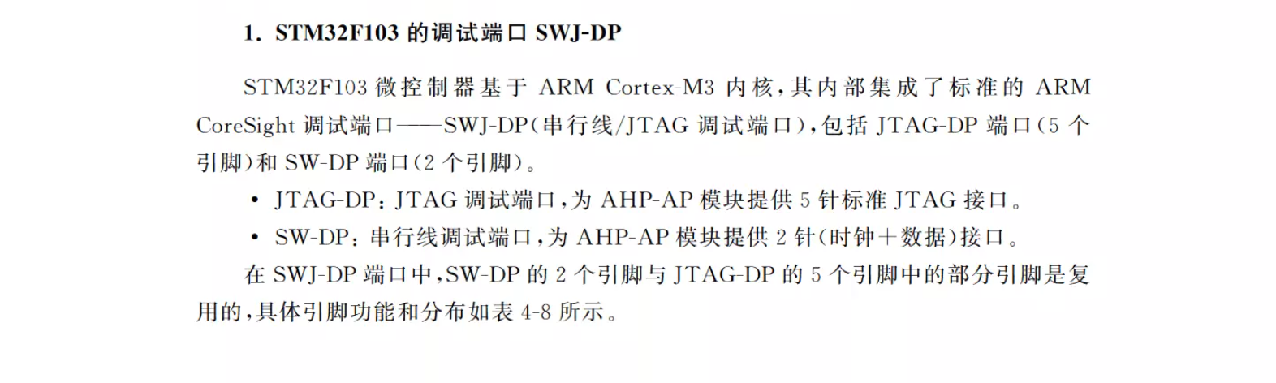
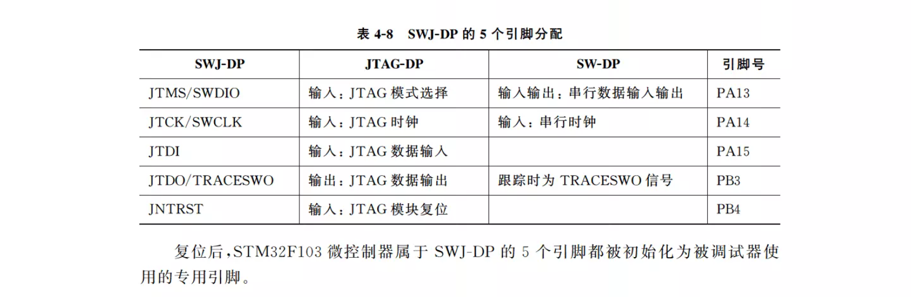
A.1.1 Basics

Slide 4
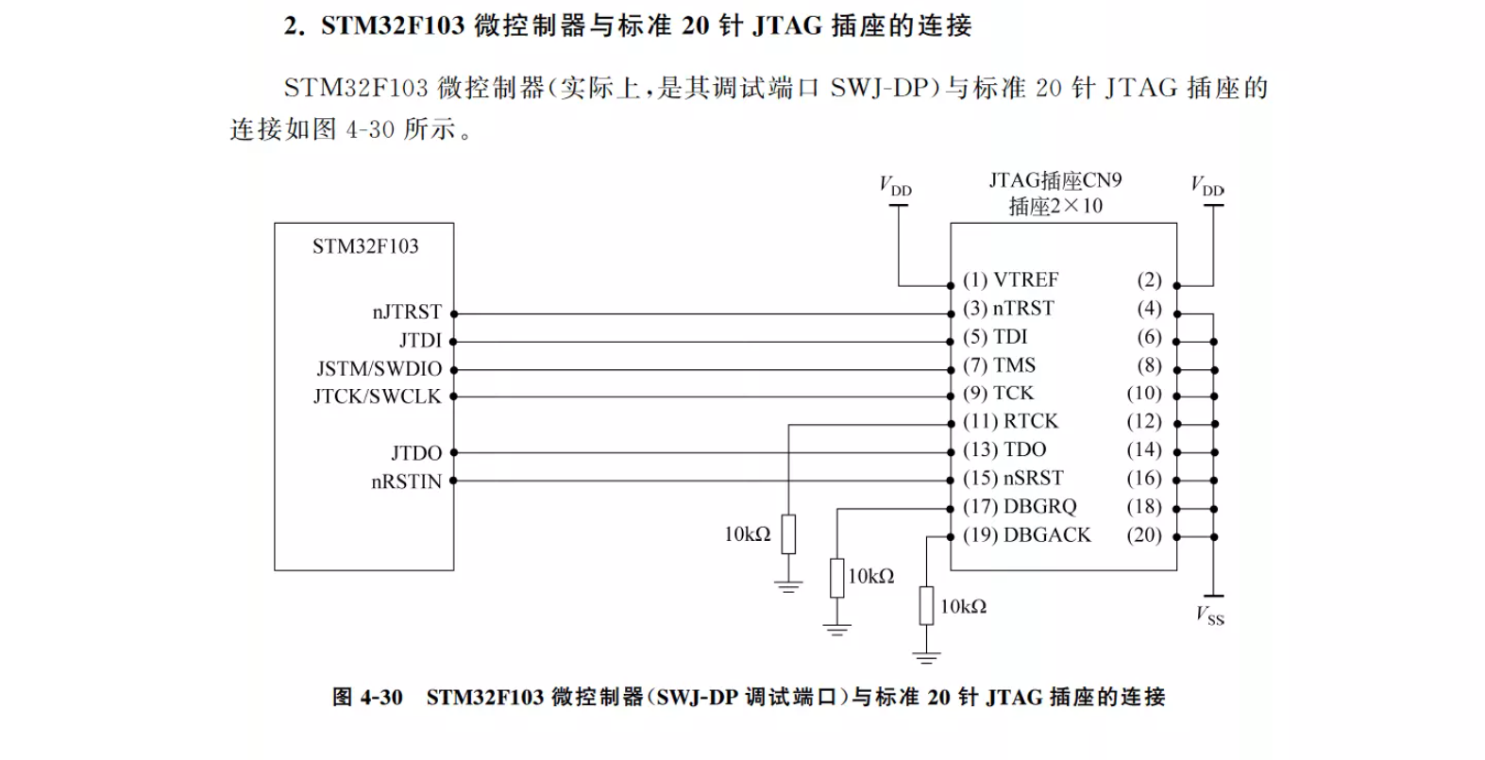
A.1.1 Basics

Slide 5
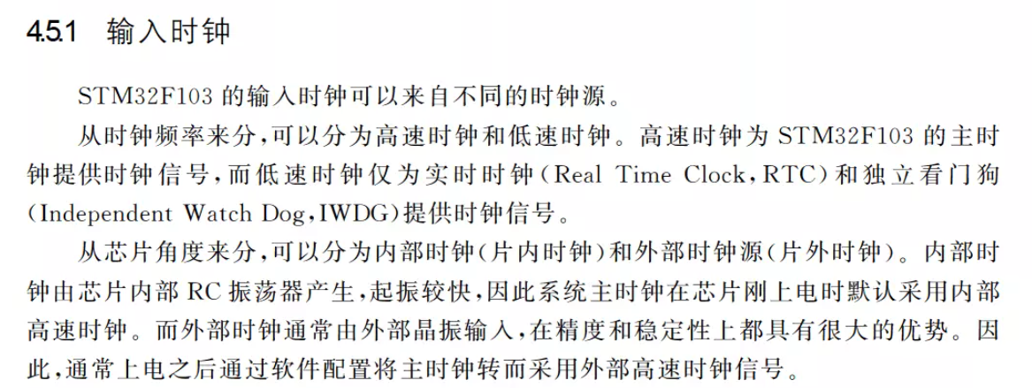
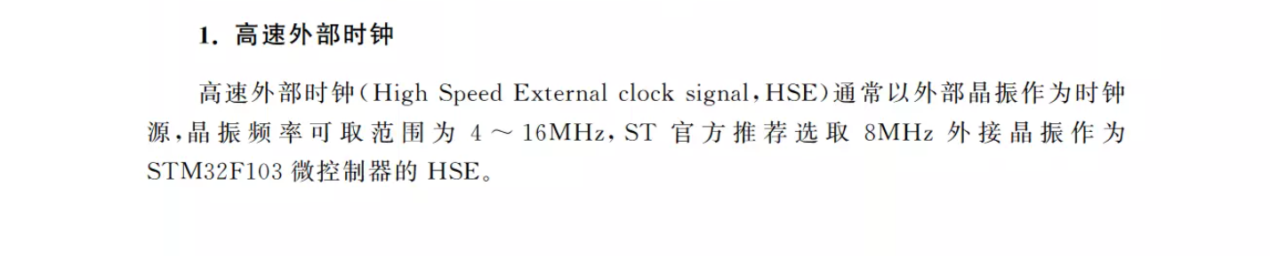
A.1.1 Basics

Slide 6
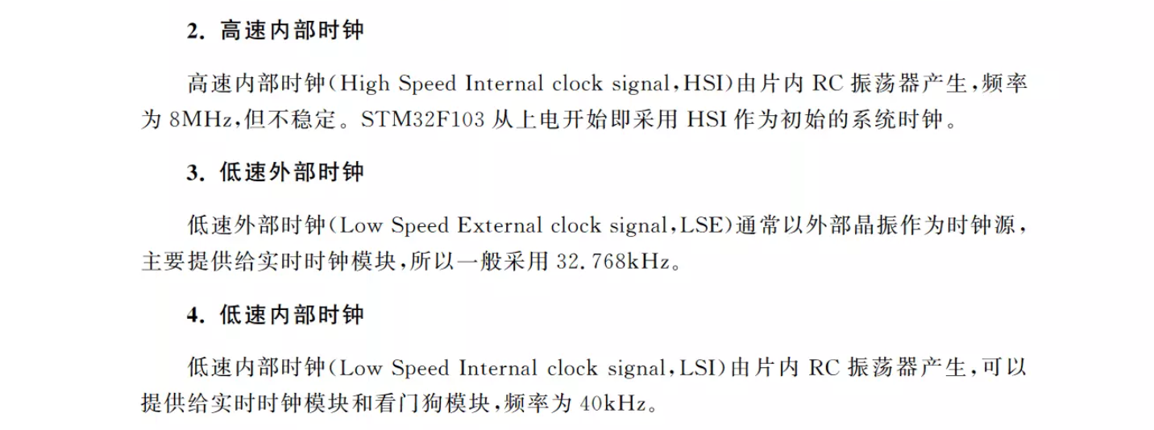
A.1.1 Basics

Slide 7
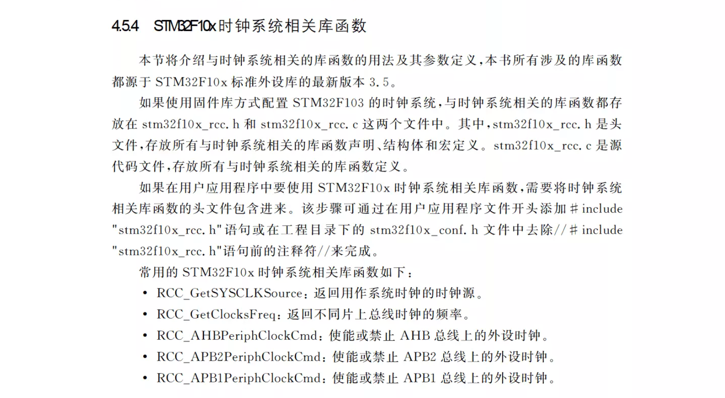
A.1.1 Basics

Slide 8
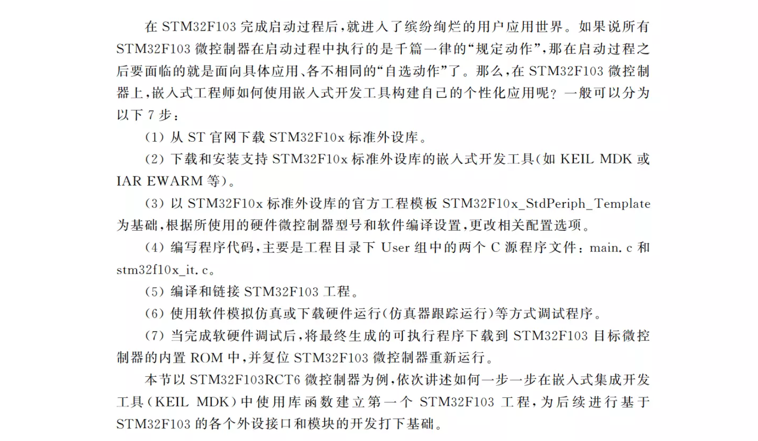
A.1.1 Basics

Slide 9
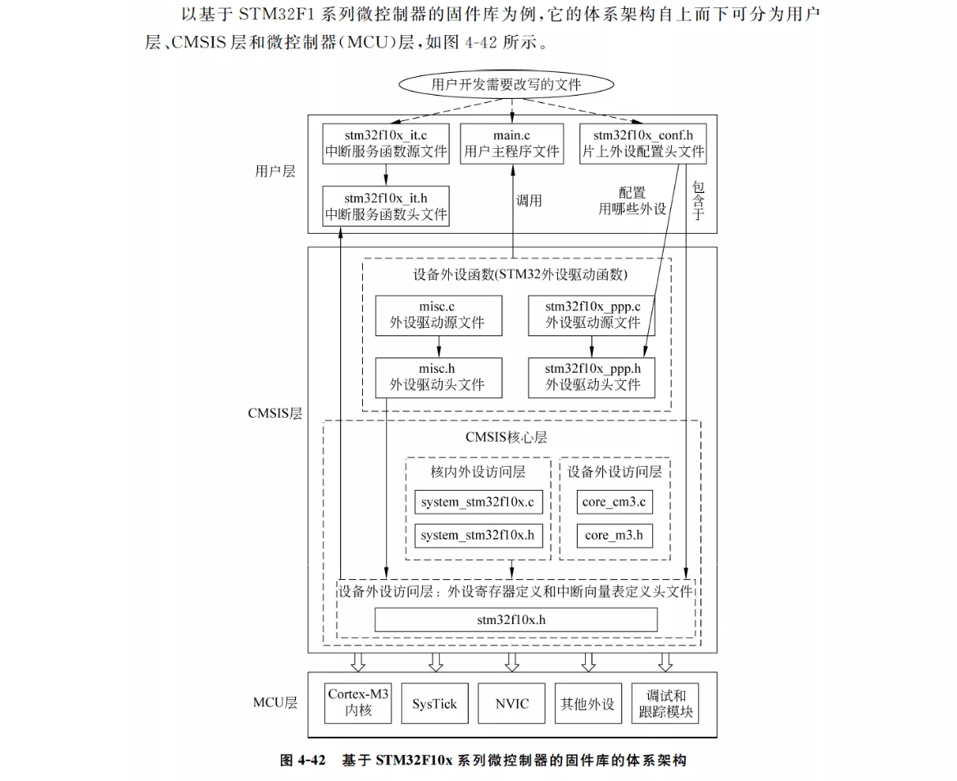
A.1.1 Basics

Slide 10
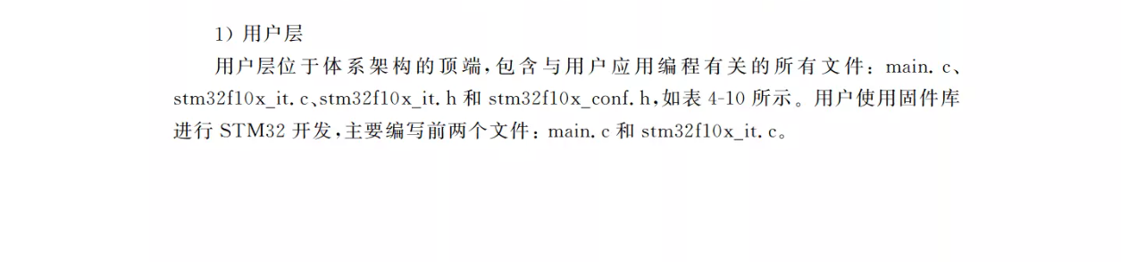
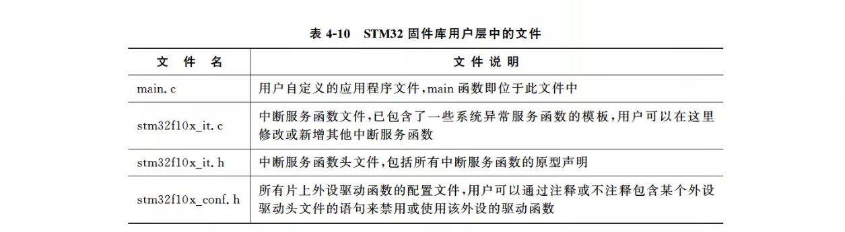
A.1.1 Basics

Slide 11
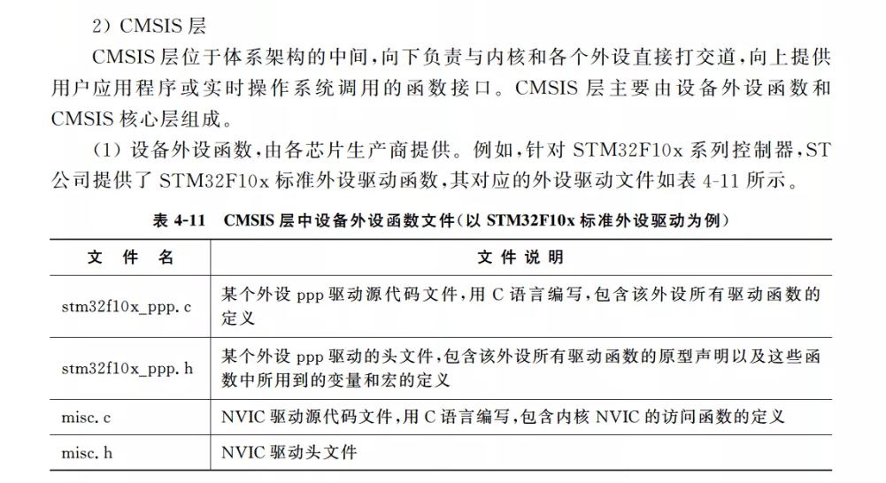
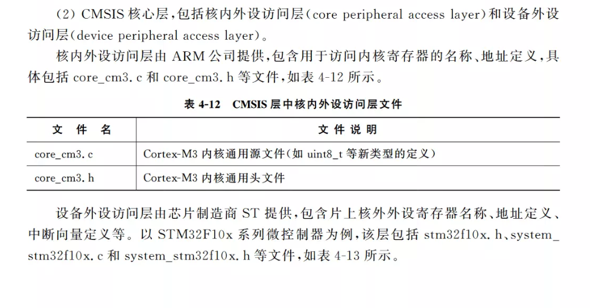
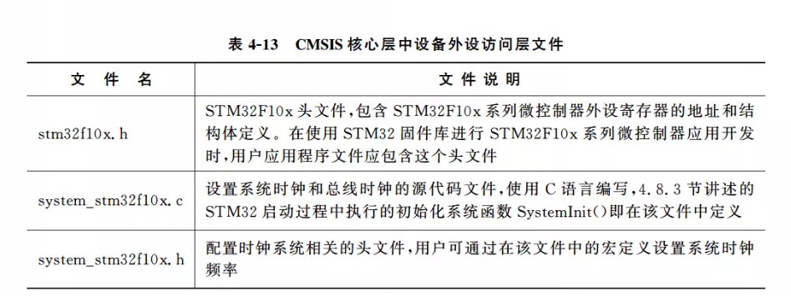

A.1.1 Basics

Slide 12
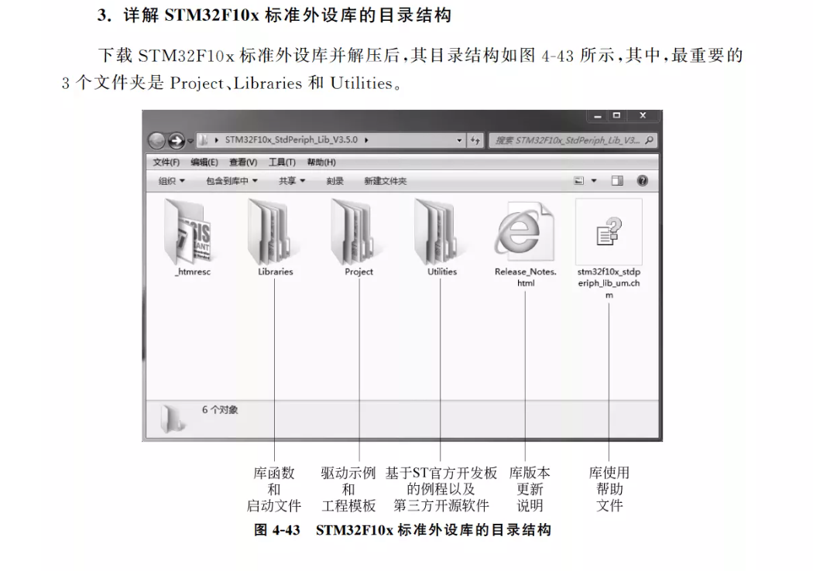
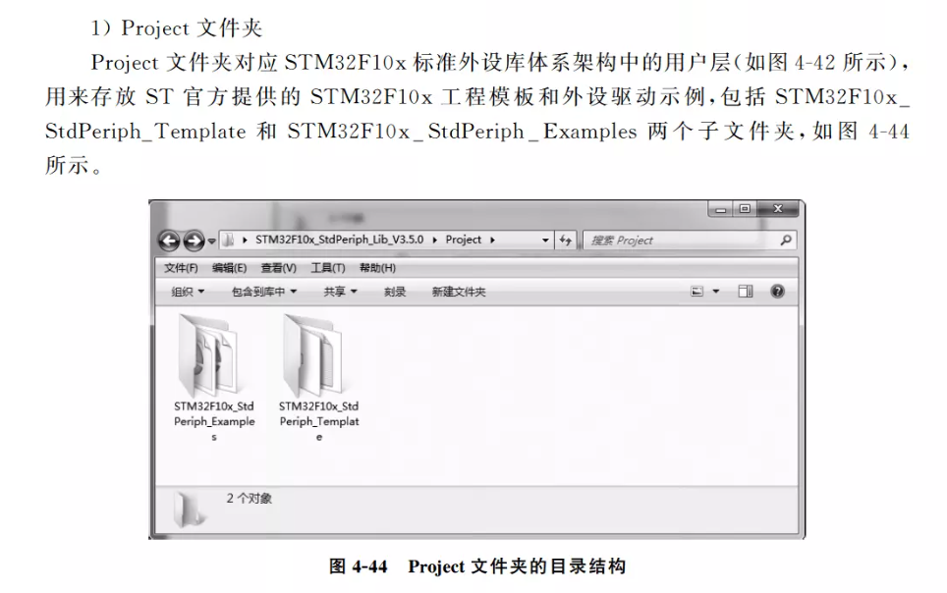
A.1.1 Basics

Slide 13
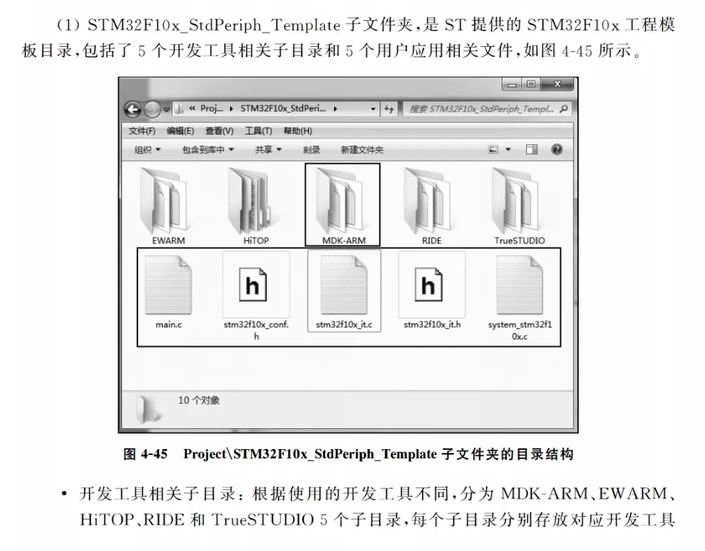
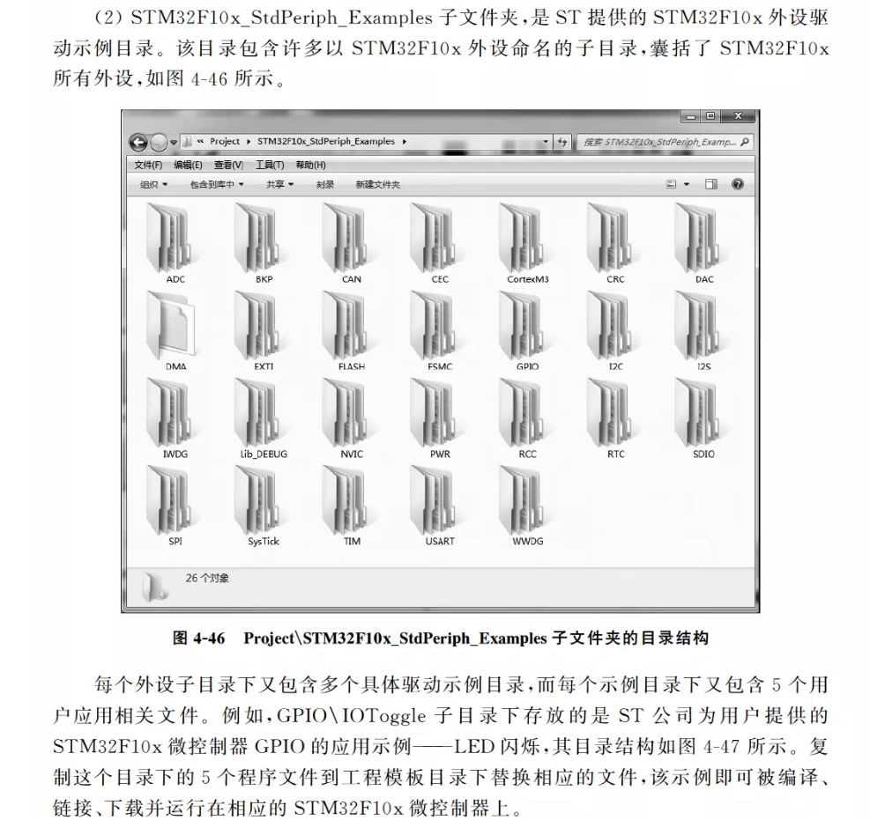
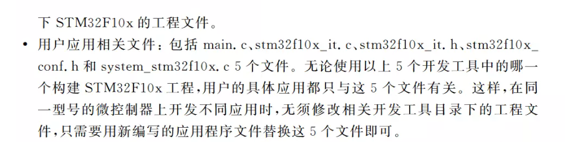
A.1.1 Basics

Slide 14
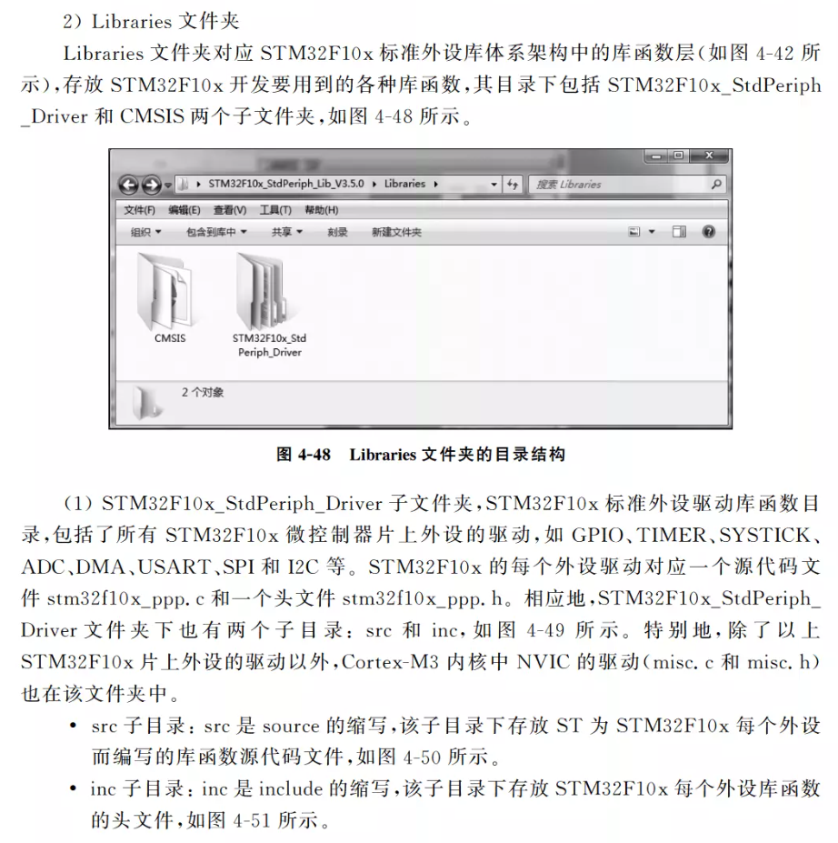
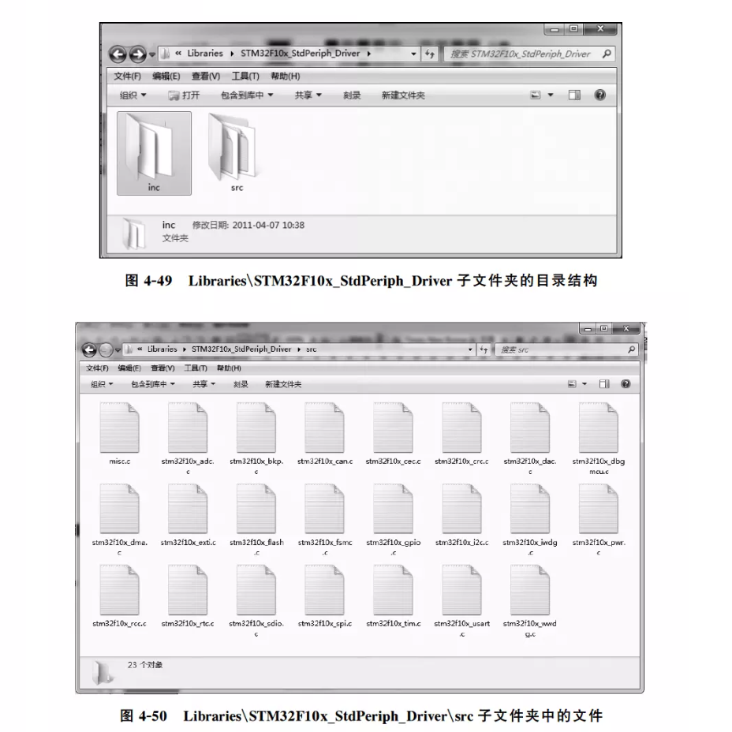
A.1.1 Basics

Slide 15
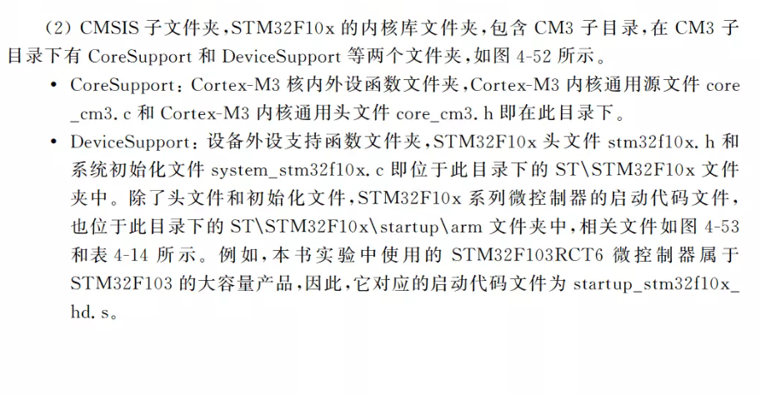
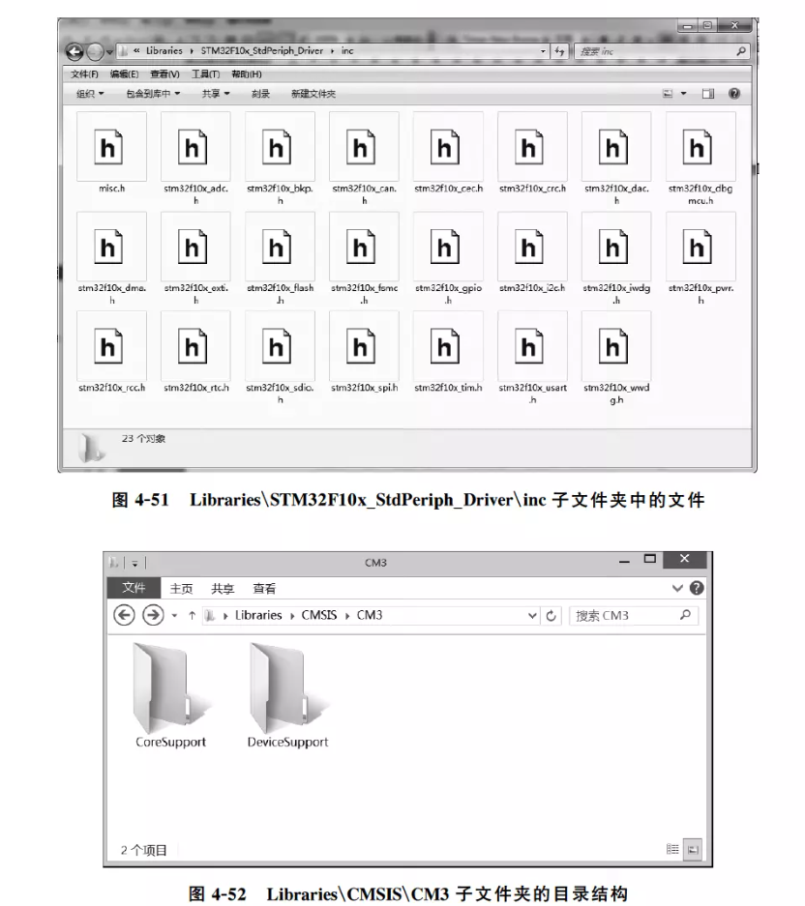
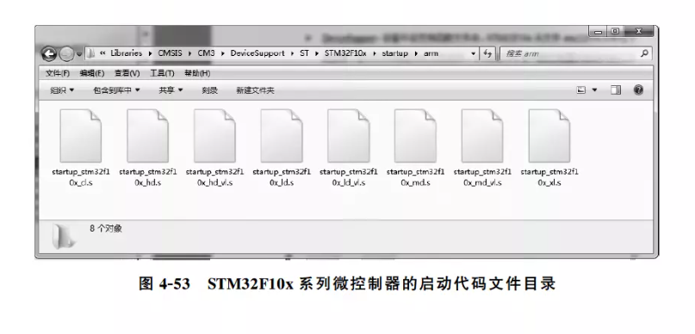
A.1.1 Basics

Slide 16
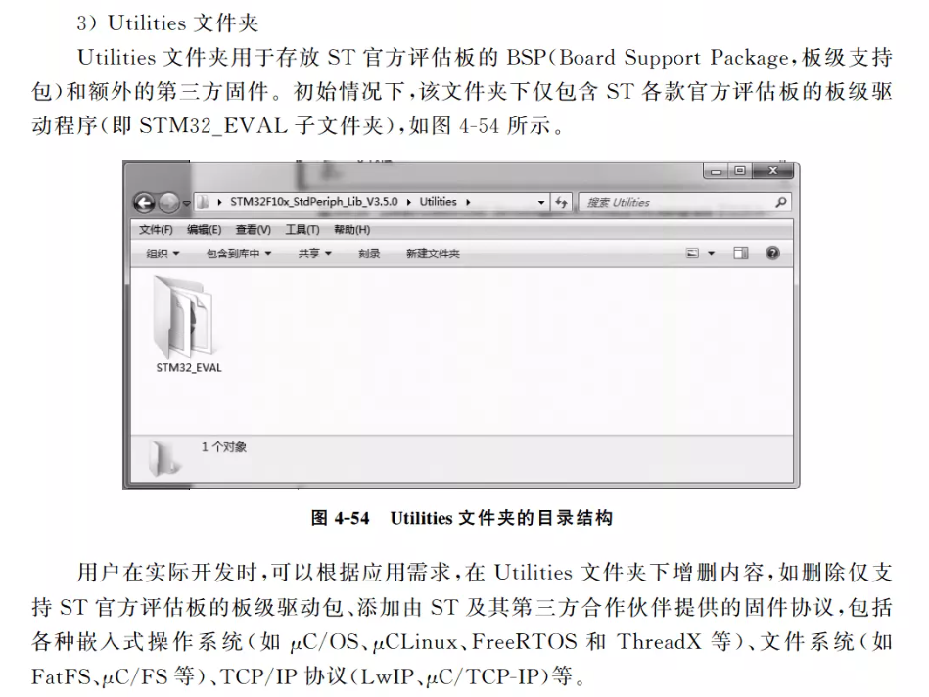
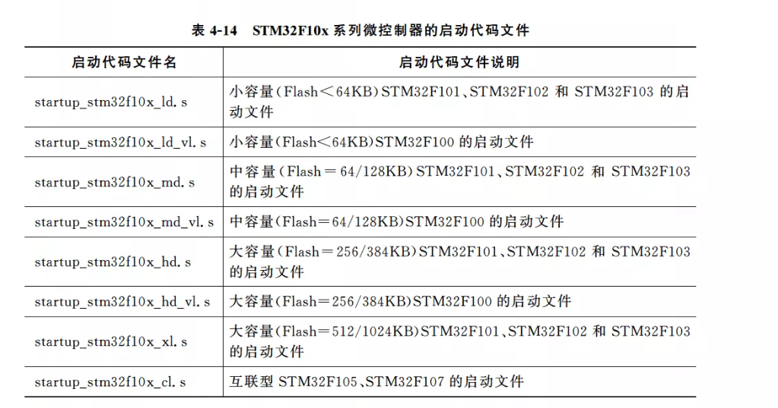
A.1.1 Basics

Slide 17
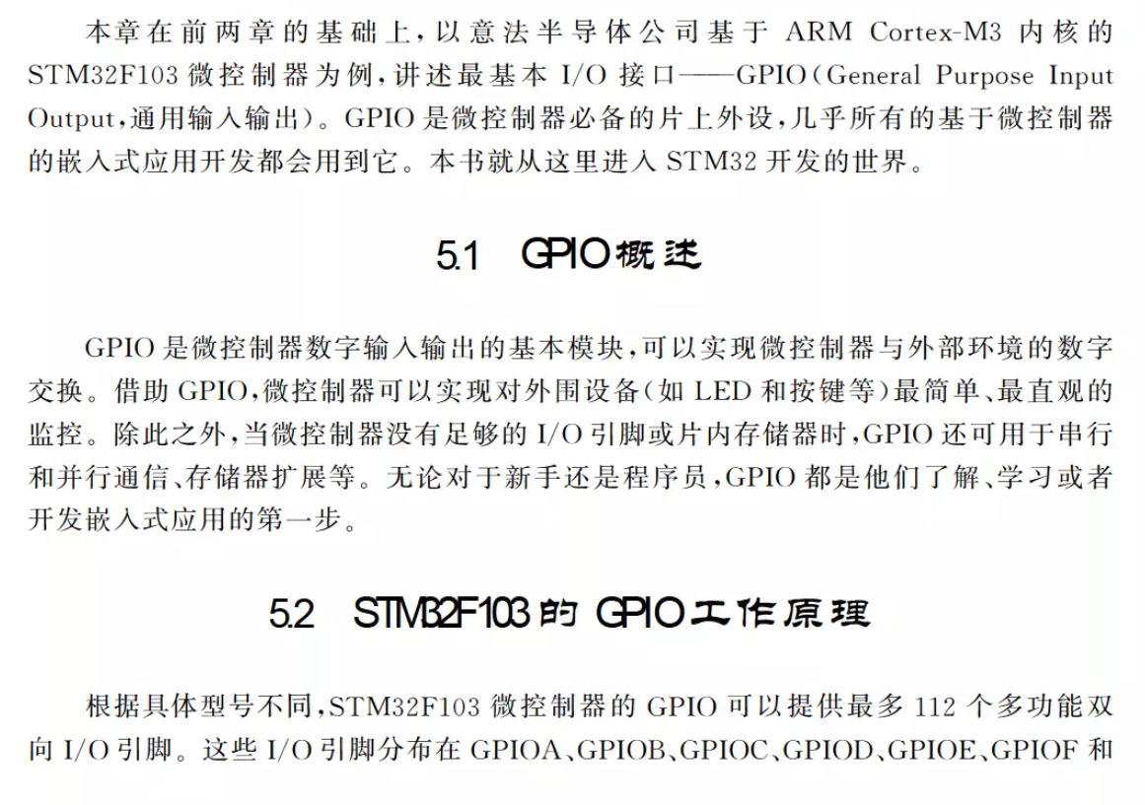
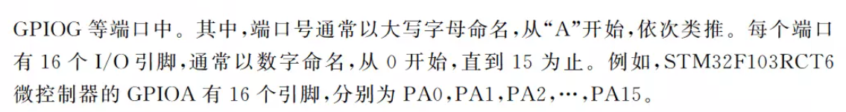
A.1.1 Basics

Slide 18
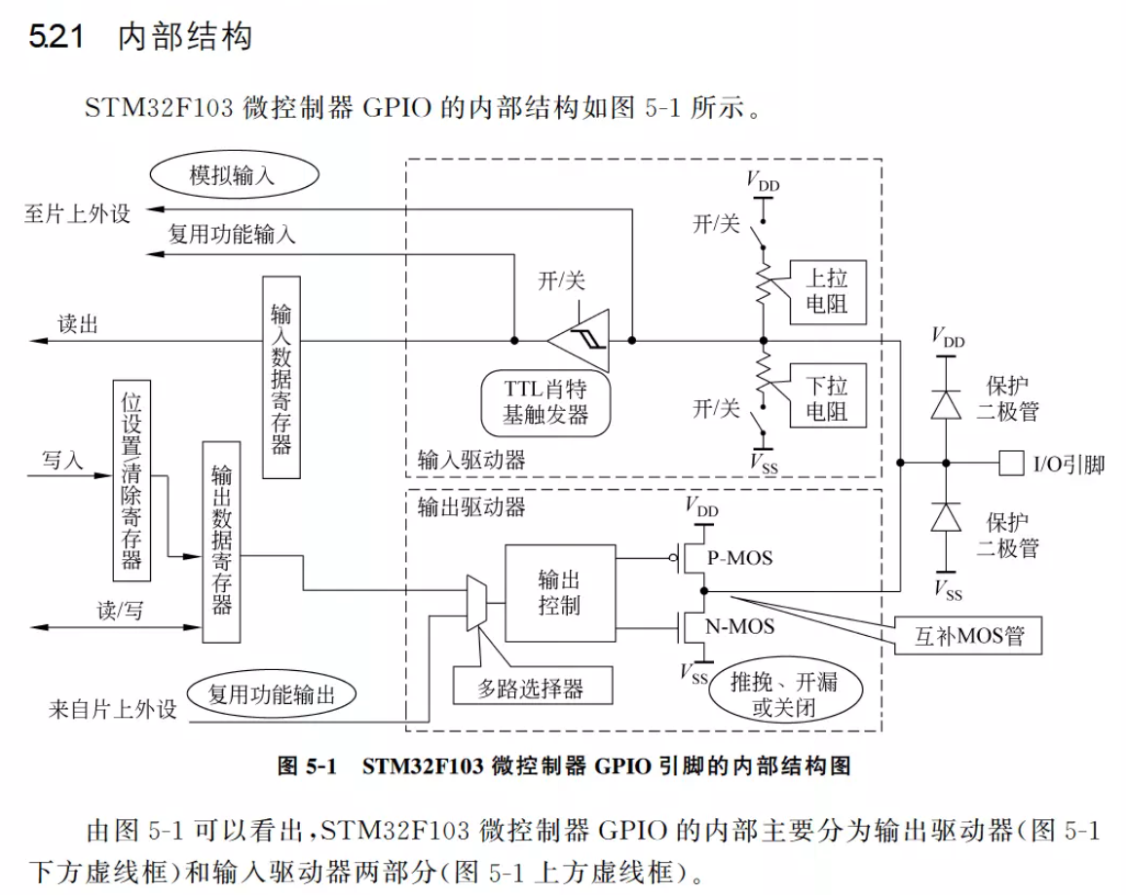
A.1.1 Basics

Slide 19
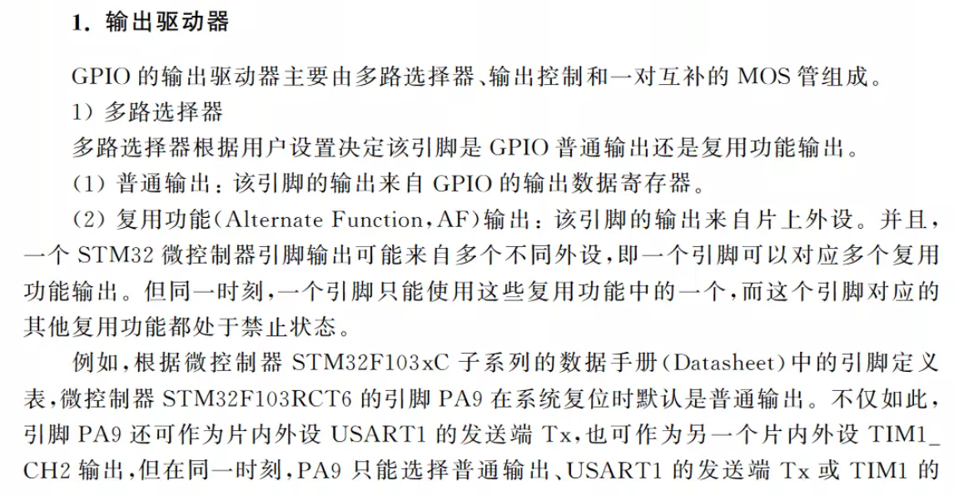
A.1.1 Basics

Slide 20
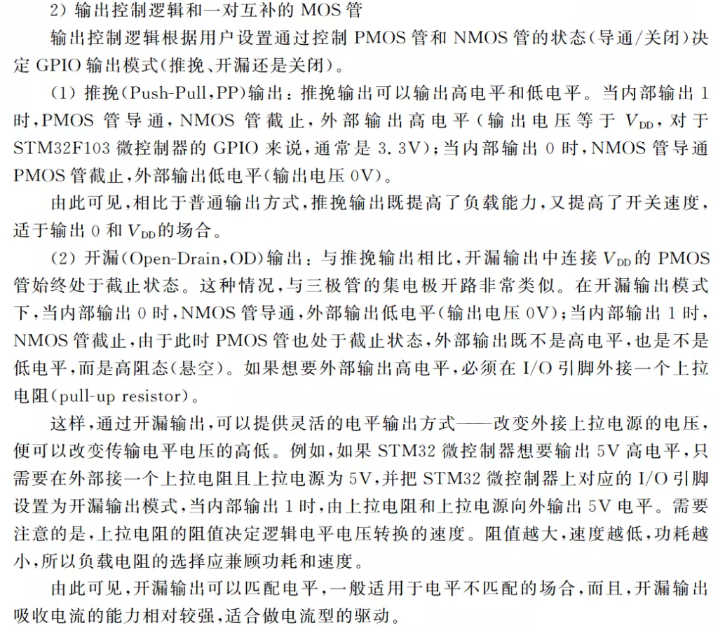
A.1.1 Basics

Slide 21
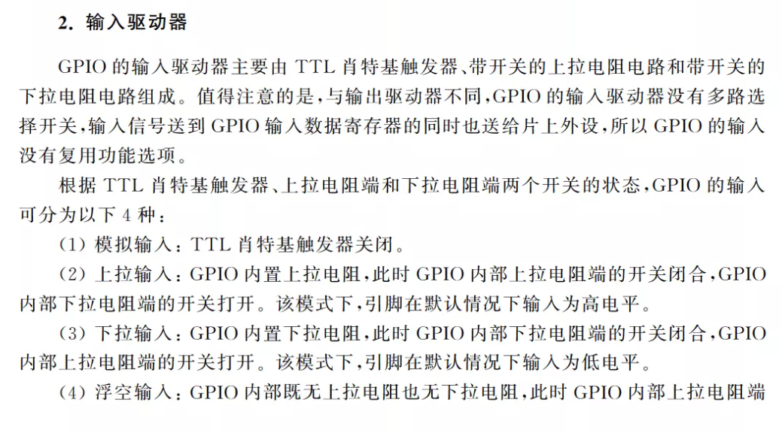
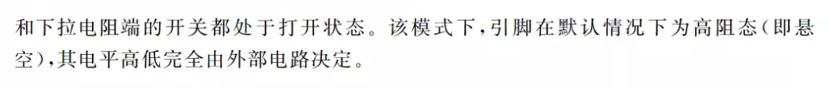
A.1.1 Basics

Slide 22
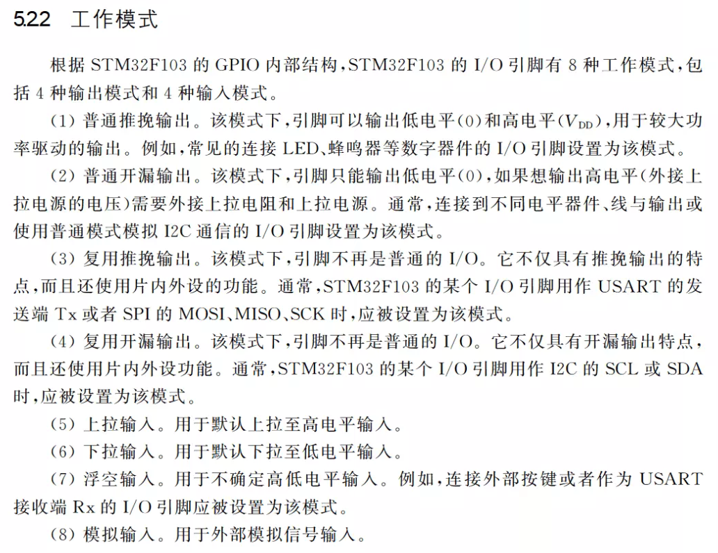
A.1.1 Basics

Slide 23
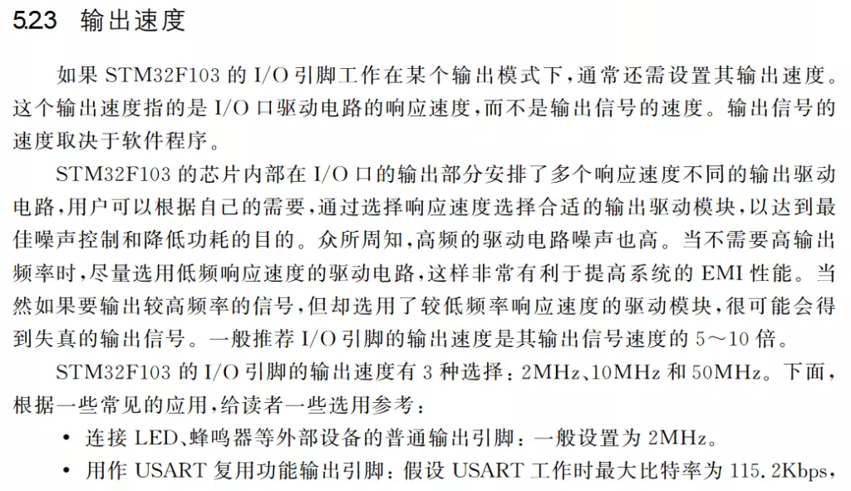
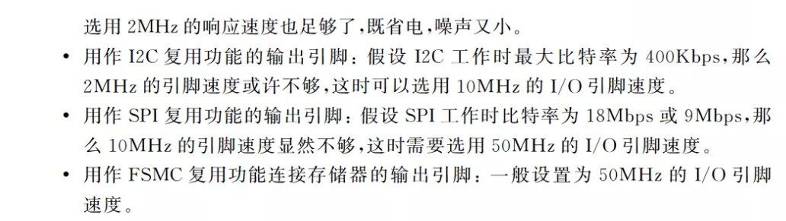
A.1.1 Basics

Slide 24
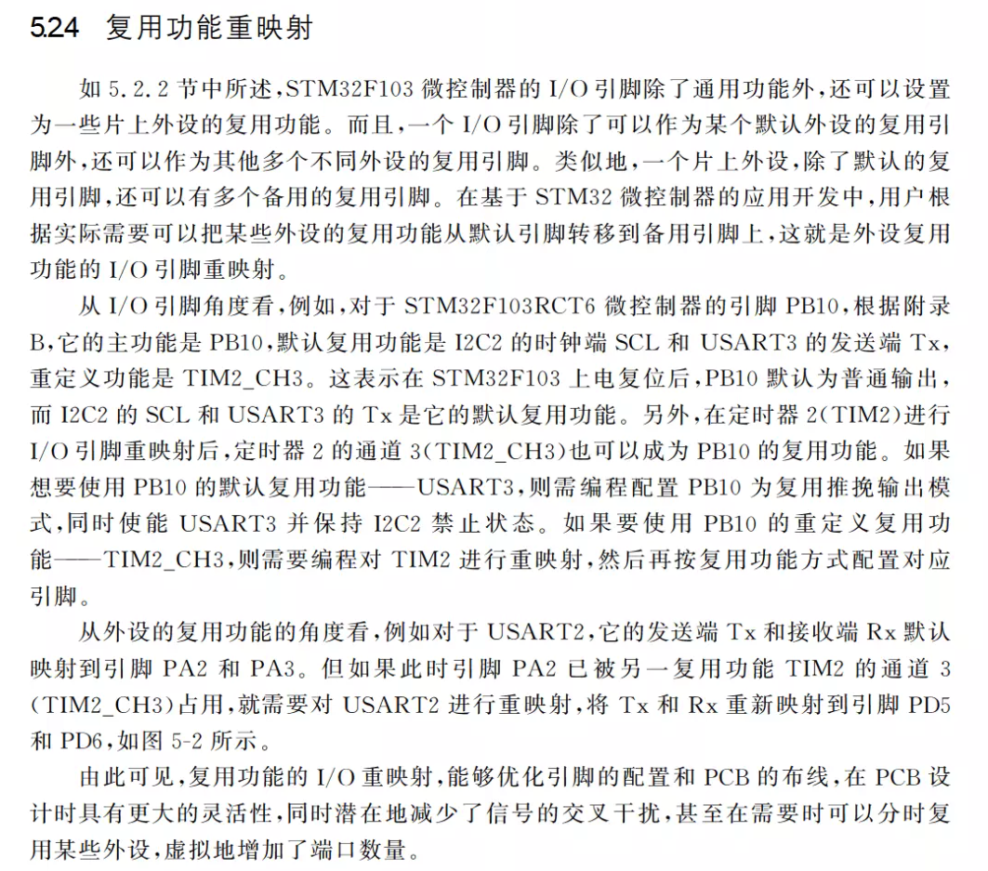
A.1.1 Basics

Slide 25
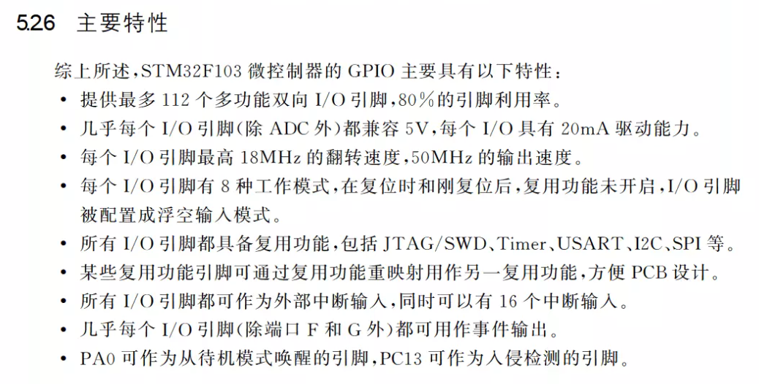
A.1.1 Basics

Slide 26
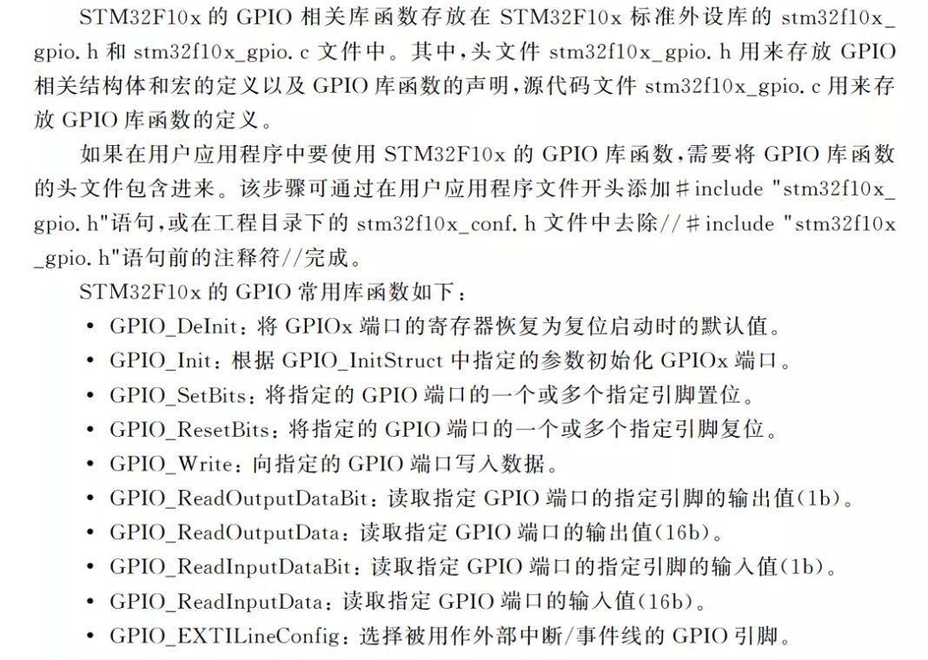
A.1.1 Basics

Slide 27
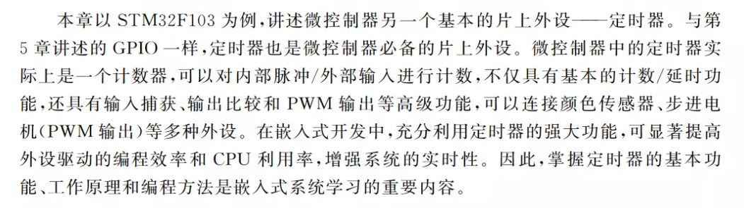
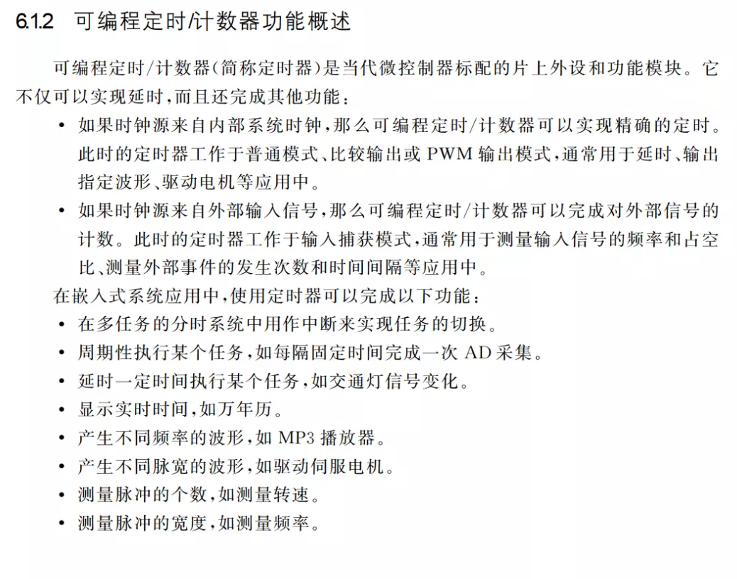
A.1.1 Basics

Slide 28
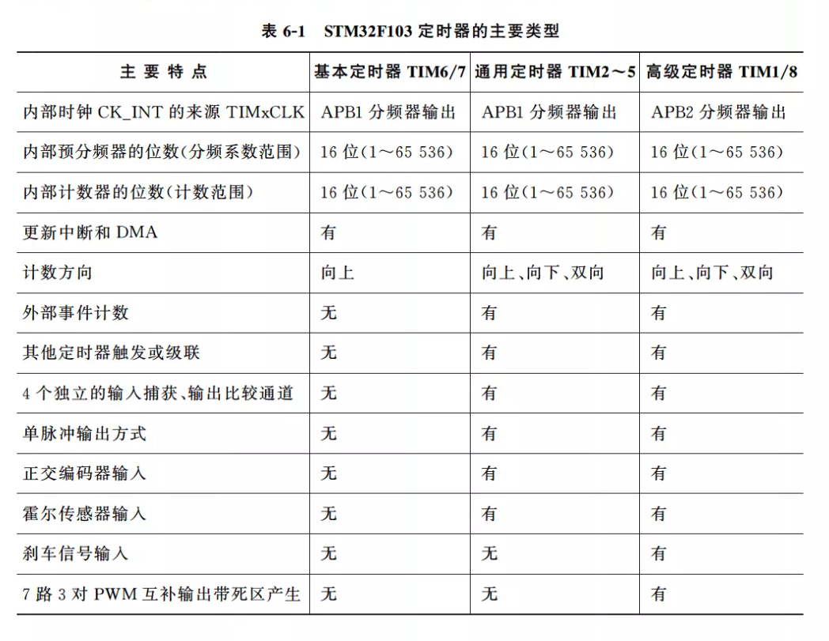
A.1.1 Basics

Slide 29
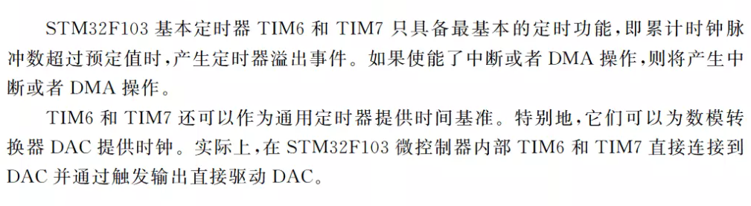
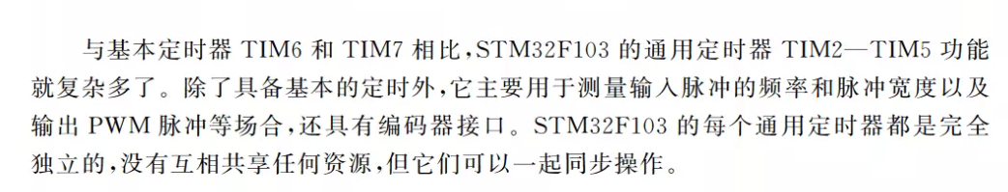
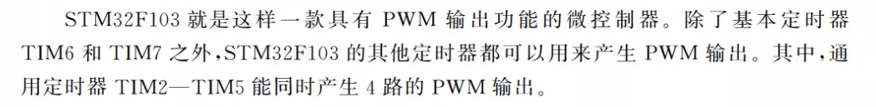
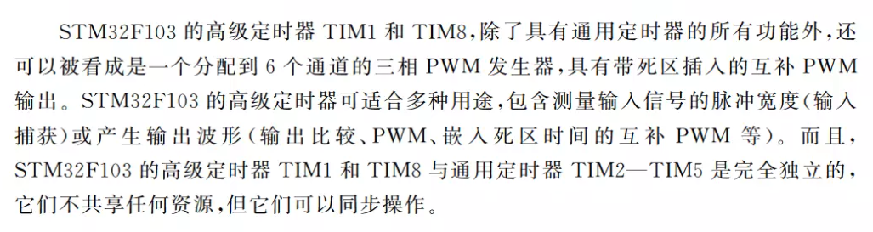
A.1.1 Basics

Slide 30
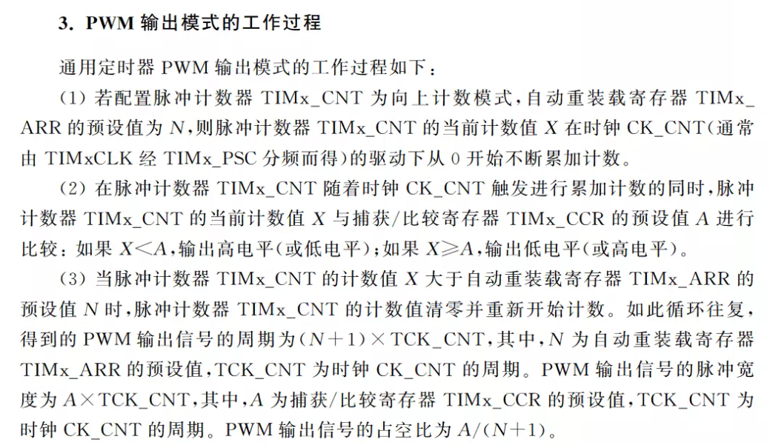
A.1.1 Basics

Slide 31
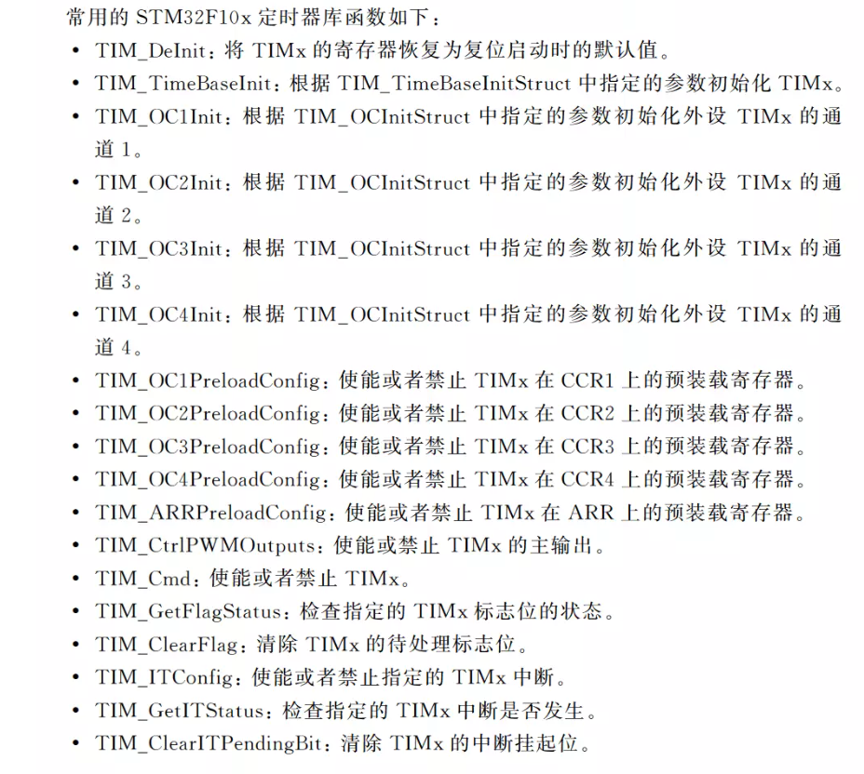
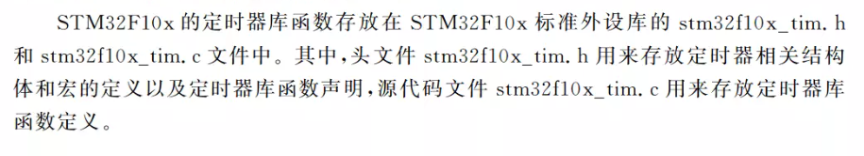
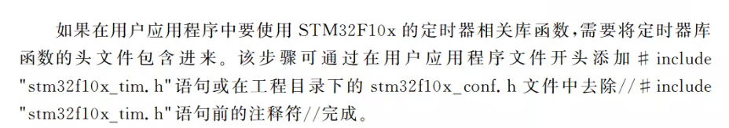
A.1.1 Basics

Slide 32

A.1.1 Basics

Slide 33

A.1.1 Basics

Slide 34

A.1.1 Basics

Slide 35

A.1.1 Basics

Slide 36

A.1.1 Basics

Slide 37

A.1.1 Basics

Slide 38


A.1.1 Basics

Slide 39


A.1.1 Basics

Slide 40


A.1.1 Basics

Slide 41

A.1.2 Basic Applications

Slide 42

A.1.2 Basic Applications

Slide 43

A.1.2 Basic Applications

Slide 44

A.1.2 Basic Applications

Slide 45

A.1.2 Basic Applications

Slide 46

A.1.2 Basic Applications

Slide 47

A.1.2 Basic Applications

